Slide 1

DIGITAL PORTFOLIO
STUDENT NAME:S.SURYA PRAKASH
REGISTER ID AND NMID:2422K2221/972498FE2A3A5CCBC17455AA68744FF5
DEPARTMENT:COMPUTER SCIENCE
COLLEGE:PURATCHI THALAIVI AMMA ARTS AND SCIENCE COLLEGE /BHARATHIYAR UNIVERSITY

Slide 2
PROJECT TITLE:DIGITAL PORTFOLIO-SURYA PRAKASH
modern protfolio website with a clean,responsive,and user-friendly design
it includes dark mode feature and smooth animations
sections:
About me
skills
project
certificate
contact

Slide 3

AGENDA
Problem Statement
Project Overview
End User
Tools And Technologies
Protfolio Design And Layout
Features And Functionality
Results And Screenshots
Conclusion
Githhub Link

Slide 4
PROBLEM STATEMENT
In today’s competitive enviroment,showcashing technical skills,projects,and Achievements is essential for carrer growth.Traditional resumes are limited In presenting interactive and visual content.There is a need for a Modren,responsive,and personalized protfolio website that highlights my Skills,projects,and certicates in a professional way.

Slide 5
PROJECT OVERVIEW
The Digital Portfolio website is a personal website built to highlight academic Background, technical skills, projects, certificates, and contact details. It Provides recruiters and peers with a professional, interactive, And modern Way to view achievements.

Slide 6
WHO ARE THE END USERS?
Recruiters/HR Managers
College Faculty for Evaluation
Fellow Developers & Collaborators
Internship/Job Providers

Slide 7
TOOLS AND TECHNIQUES
Frontend: HTML5, CSS3, JavaScript
Icons: Font Awesome
Animation & Effects: Typing effect, Dark mode toggle, Smooth scrolling
Hosting: GitHub Pages
Tools:VS CODE

Slide 8
PORTFOLIO DESIGN AND LAYOUT
Clean, modern single-page layout
Sections: Home, About Me, Skills, Projects, Certificates, Contact
Responsive design with dark mode support
Smooth navigation and UI-friendly interactions

Slide 9
FEATURES AND FUNCTIONALITY
About me:Personal introduction with typing effect
Projects e-shop showcase with live demo links
Certificates section for achievements
Contact me with email and whatsapp
Dark/Light mode switch for accessibility
Responsive design for mobile and desktop

Slide 10
RESULT
Working portfolio website hosted online
Successfully displays personal details, projects, and certificates
Easy navigation and user-friendly UI
Attracts recruiters by showcasing both skills and creativity

Slide 11
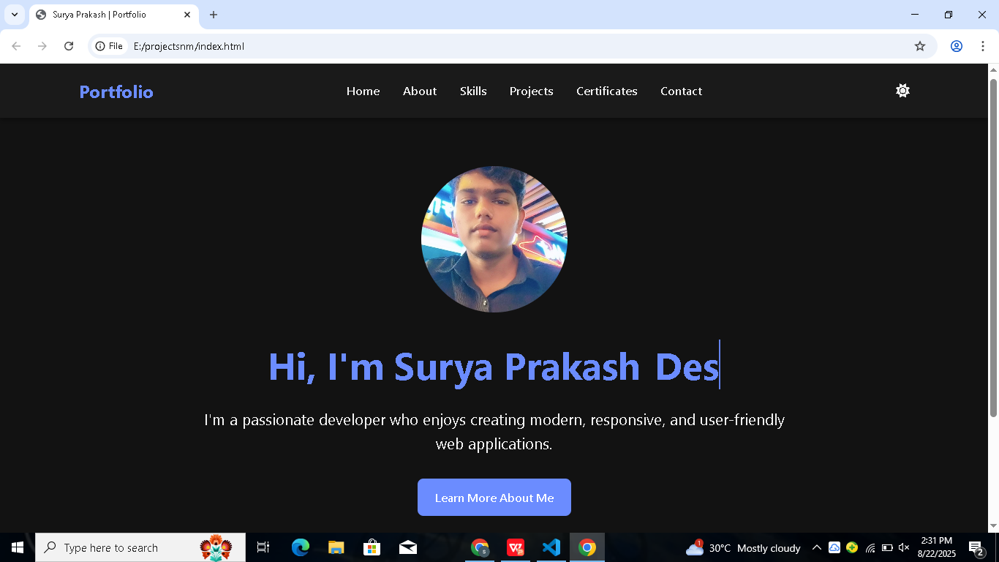
SCREEN SHOT 1

Slide 12
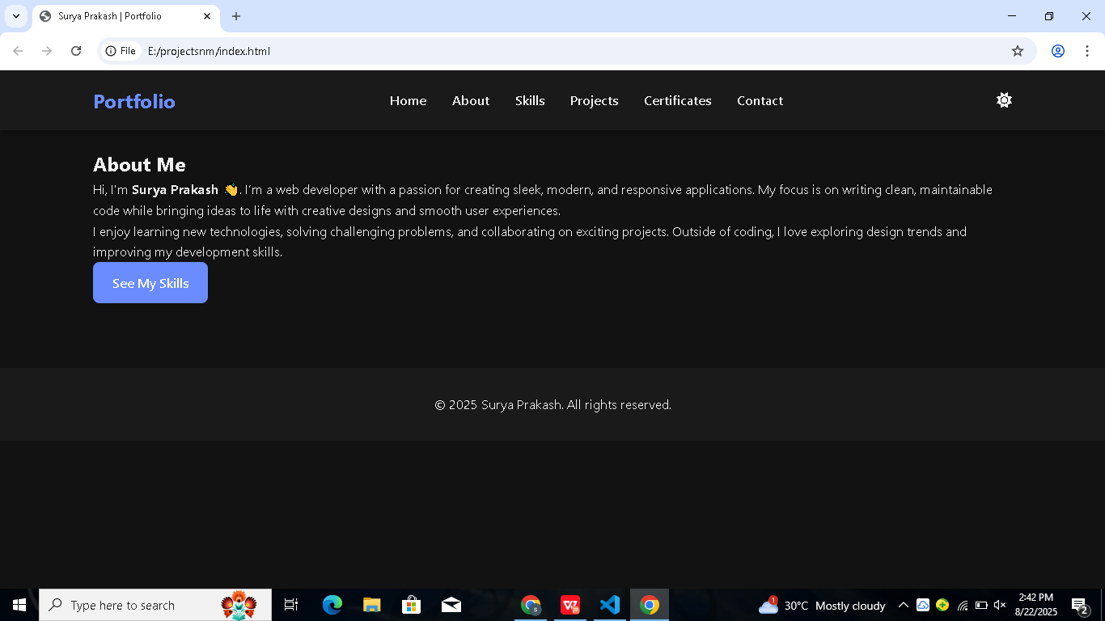
SCREEN SHOT2

Slide 13
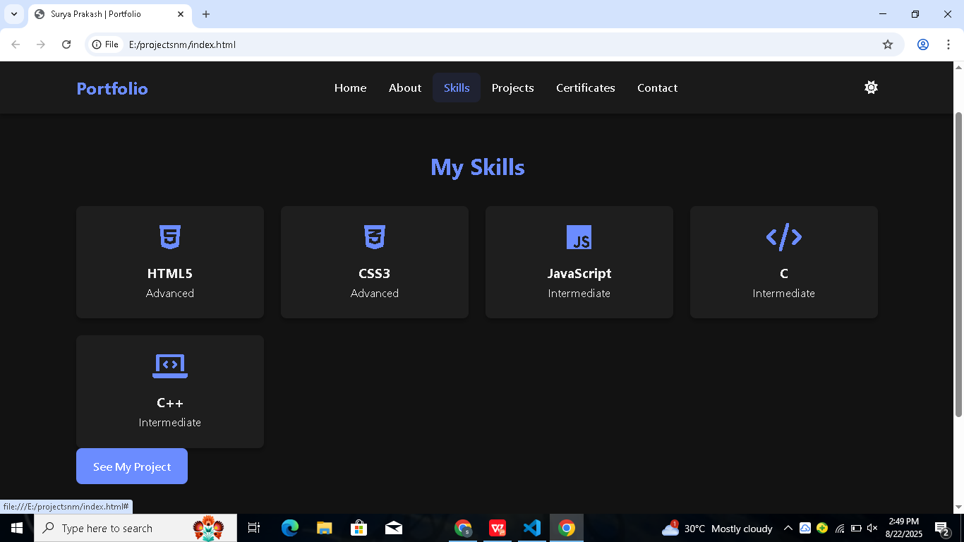
SCREEN SHOT 3

Slide 14
CONCLUSION
The digital portfolio acts as a modern resume, improving online visibility, Professionalism, and opportunities for internships and jobs. It Demonstrates both technical skills and personal branding.

